Slide 1

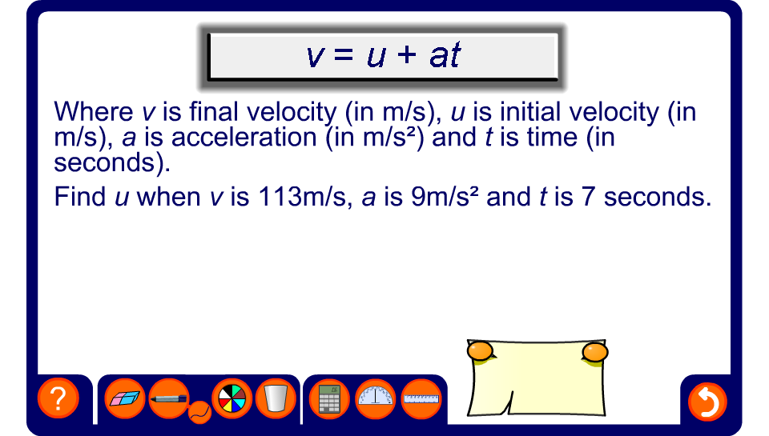


Problems that lead to equations to solve

